Slide 1

SMART INTELLIGENT TRAFFIC CONTROL SYSTEM FOR EMERGENCY VEHICLES
PROJECT GUIDE : Mr. R. V. S. RATNA KUMAR (Assistant professor)
REG NO | NAME
20NM1A1252 | S. RESHMA
20NM1A1218 | K. SHALINI
20NM1A1232 | N. SADHANA
20NM1A1231 | N. ANOOHYA

Slide 2
CONTENT
Abstract
Literature survey
Existing System
Proposed System
Flow chart
Components
Execution
Conclusion
References

Slide 3

ABSTRACT
The rise in population due to industrialization and urbanization has led to increased traffic congestion and challenges for emergency vehicles like ambulances. To address this issue, a "Smart intelligent traffic control system for emergency vehicles" has been proposed. This system integrates sound sensor technology with traffic signal control systems to automatically activate green lights for ambulances in congested areas. It also prioritizes high-density roads when ambulance detection is absent and uses blue indicator lights to signal ambulance presence at signals. Overall, the project aims to optimize traffic flow, improve emergency response times, and enhance road safety in urban environments.

Slide 4
LITERATURE SURVEY
S.NO. | TITLE | PUBLICATION | METHOD
1 | Smart Ambulance System using IoT | IEEE | The proposed system aims to reduce traffic congestion and fatal accidents by segregating heavy and light vehicles into separate lanes, thereby addressing critical issues in urban traffic management.
2 | Intelligent Traffic Control System for Smart Ambulance | IEEE | The project aims to improve ambulance movement and emergency response efficiency in congested cities like Chennai through an intelligent automatic traffic control system using RFID technology and cloud networking.
3 | Smart Traffic Management System | IEEE | The project integrates health monitoring and traffic control in ambulances, using RF communication for data transmission to hospitals and traffic management, with potential real-time upgrades through GPS and congestion detection.

Slide 5
EXISTING SYSTEM
Human life is precious and must follow safety measures very conscious in all aspects this of course includes ambulances services too.
In this, by using intelligent ambulance system we can achieve the uninterrupted service of the traffic control system by implementing the alternate methods for signal change to Allow flow control.
The accuracy of the RFID is more than Camera’s, So this existing system improves the performance of traffic light Violation Detection System.

Slide 6
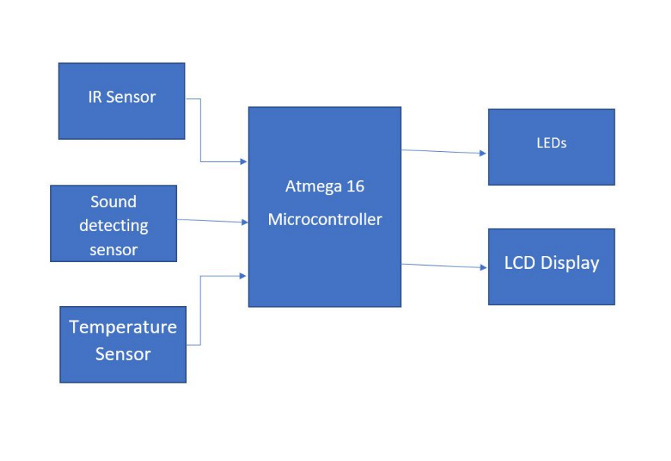
PROPOSED SYSTEM

Slide 7
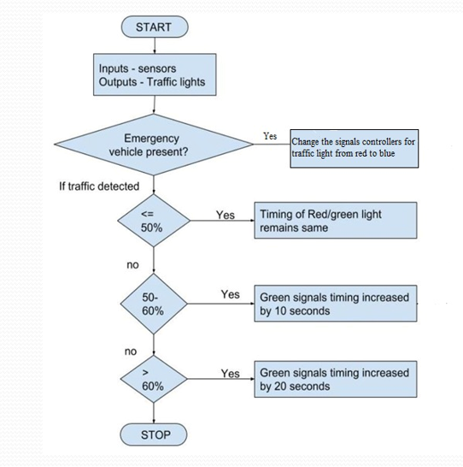
FLOW CHART

Slide 8
COMPONENTS BEING USED
Arduino Microcontroller
Infrared Proximity Sensors
Sound Sensor
Temperature Sensor
LCD Display

Slide 9
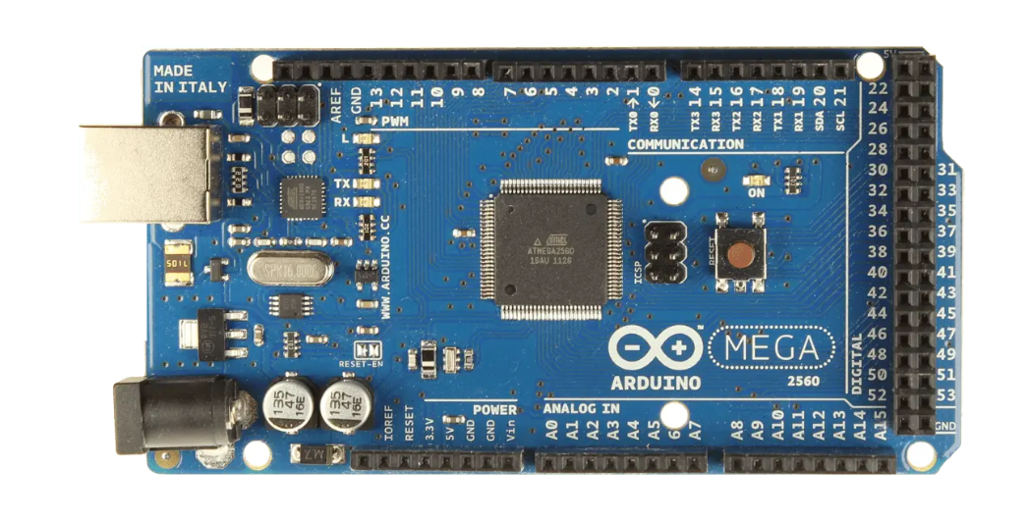
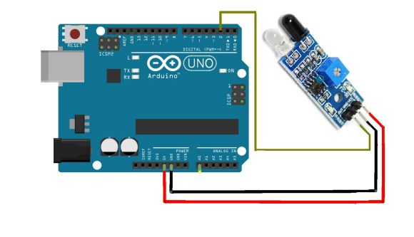
Arduino Microcontroller
Arduino is an open source, computer hardware and software company, project, and user community that designs and manufactures microcontroller kits for building digital devices and interactive objects that can sense and control objects in the physical world.
Infrared Proximity Sensors
An Infrared Proximity Sensor consists of a IR Emitter and IR Receiver embedded on a single chip. It measures distance by shining a beam of infrared light and uses a phototransistor to measure the intensity of the light that bounces back.

Slide 10
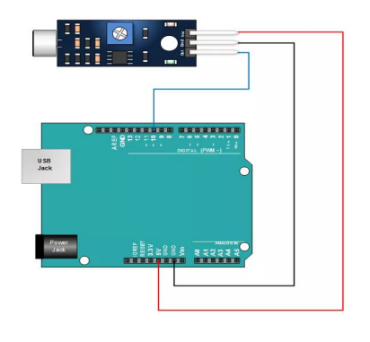
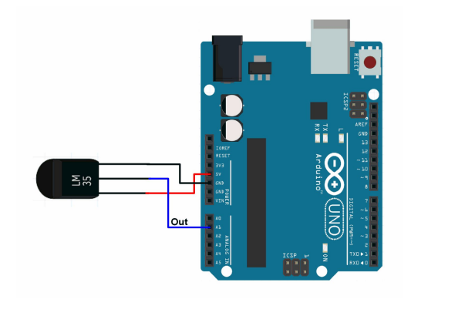
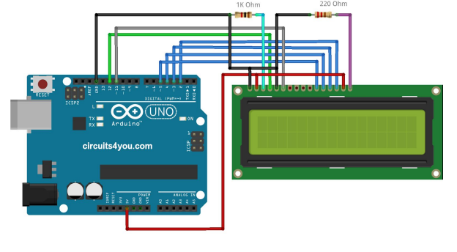
Sound Sensor
LM386 is an audio power amplifier with features of low power consumption, adjustable voltage gain, wide voltage power supply, less requirements on peripheral components and minimum total harmonic distortion.
Temperature Sensor
In the features of lm35 it is given to be +10 mills volt per degree centigrade. For example if the sensor is outputting 100 mills volt at vout pin the temperature in centigrade will be 10 degree centigrade.
LCD Display
The principle behind the LCD’s is that when an electrical current is applied to the liquid crystal molecule. This causes the angle of light which is passing through the molecule of the polarized glass and also cause a change in the angle of the top polarizing filter.

Slide 11
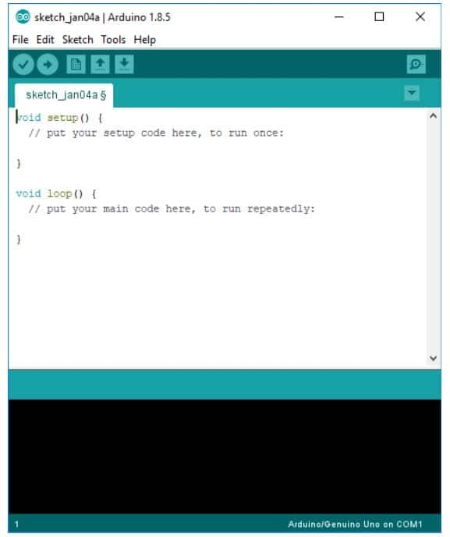
EXECUTION
The Arduino Software (IDE) runs on Windows, Macintosh OSX, and Linux operating systems. Most microcontroller systems are limited to Windows.
Fig : ARDUINO IDE

Slide 12
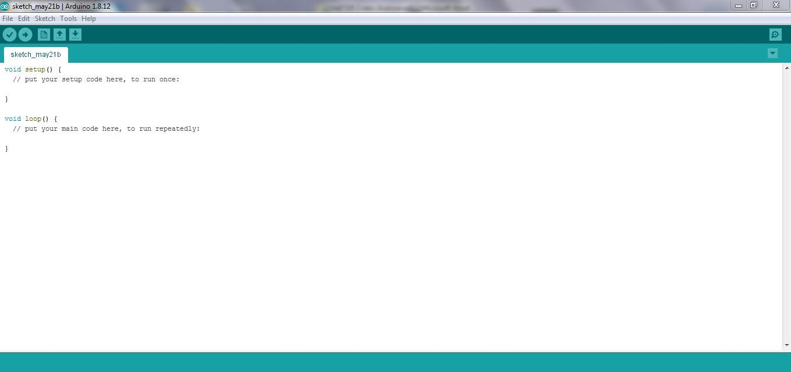
Writing and Uploading the Arduino Code
Step 1: Create a new sketch by clicking on the File→New.
Step 2: After finishing the code select the board to upload the code by clicking
Tools → Board.
And also select the port through Tools→Port.
Fig : New Sketch

Slide 13

Fig : Connection to Port
Step 3: After selection of board and port connect one end of the USB cable to the USB port and the other end to Arduino board. And click on “Verify” and then “Upload” the code if there are no mistakes in the code. Once, the code is uploaded remove the USB cable. And the board is ready to use for the required task.

Slide 14
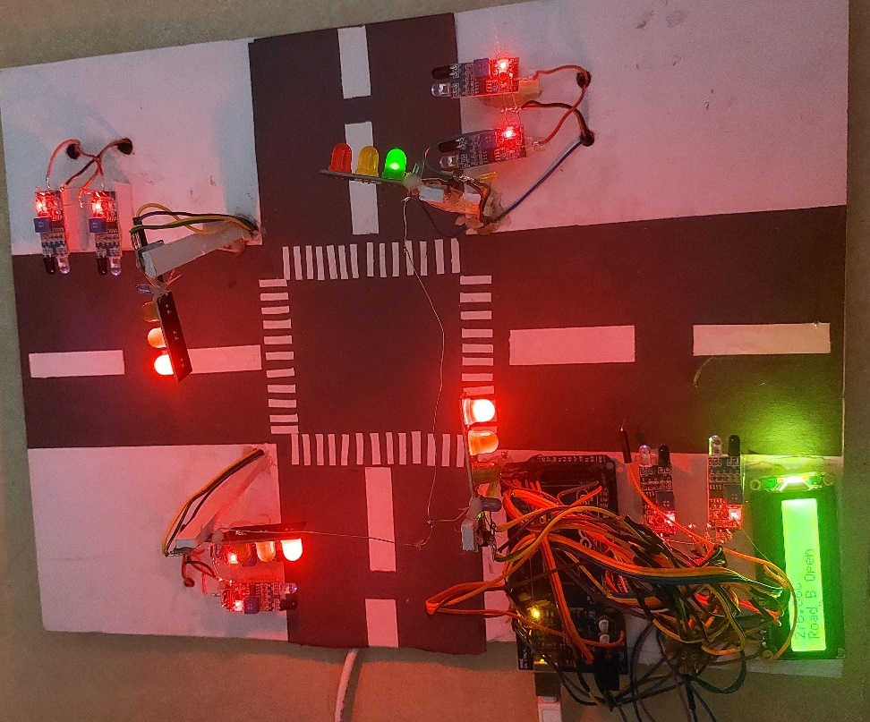
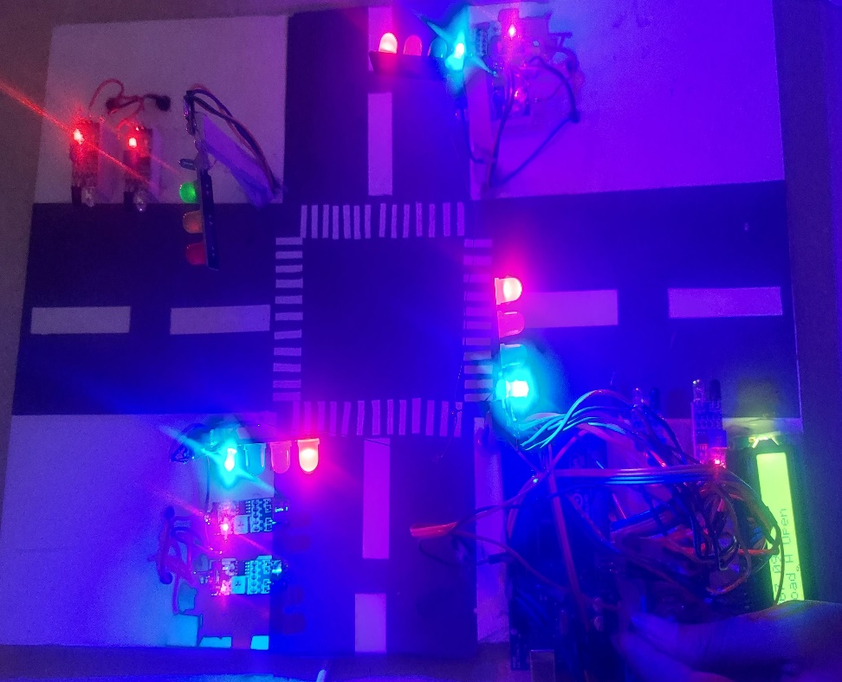
RESULT ANALYSIS

Slide 15
CONCLUSION
The proposed system integrates sound sensor technology with traffic signal control to prioritize emergency vehicles, activate green lights, and allocate priority on high-density roads, reducing congestion.
A blue indicator light signals ambulance movement, enhancing public awareness.
This approach optimizes traffic flow, improves emergency response, and enhances road safety in urban areas.

Slide 16
REFERENCES
[1] Omkar Udawant , Nikhil Thombare, Devanand Chauhan, Akash Hadke , Dattatray Waghole JSCOE “Smart Ambulance System using IoT”, DOP 2017.
[2] Prof. Deepali Ahir, Saurabh Bharade, Pradnya Botre, Sayali Nagane, Mihir Shah, “Intelligent Traffic Control System for Smart Ambulance” , Volume 5 , Issue 6 , DOP June 2018.
[3] G. Tejaswini, S. Kalyani, T. Sreeja, N. Reshma, B Amrutha, “Smart Traffic Management System”, Volume 8, Issue 5, DOP May 2020.
[4] Salem Jeyaseelan W. R, Rajkumar Krishnan, Arunkumar M, Parameswari ALAGARSAMY “Efficient Intelligent Smart Ambulance Transportation System using Internet of Things”, DOP 2024.
[5] B. Janani, Saradha, G. Vijayshri, T. Subha, “Intelligent Traffic Signal Control System For Ambulance Using RFID And CLOUD”, DOP 2022.

Slide 17
THANK YOU

